Slide 1
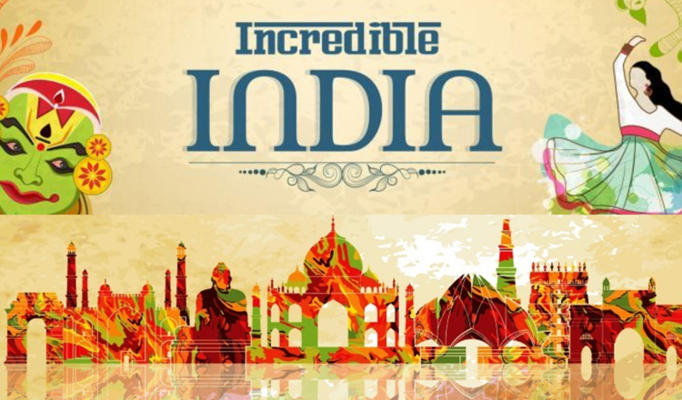

Slide 2
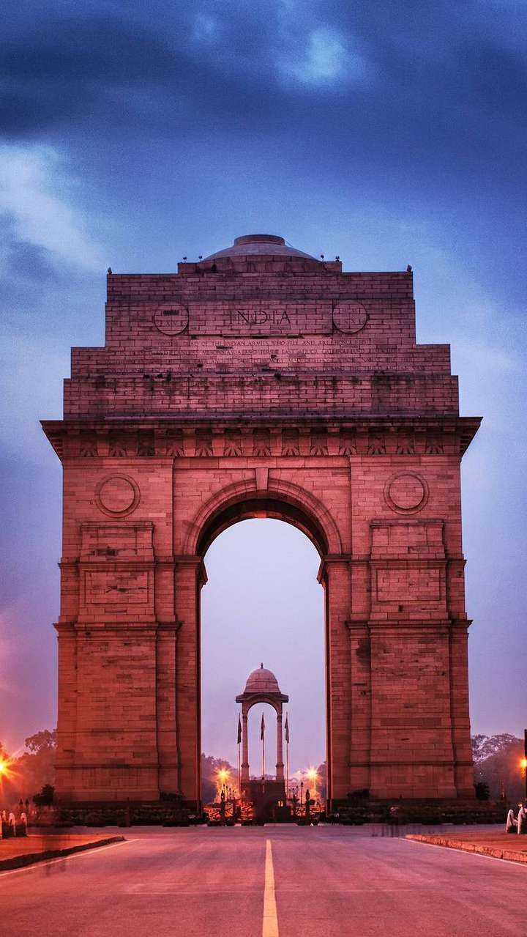
Contents
Introduction
A short film on Incredible India
Explore Indian Culture and Tradition
Topology
Languages
Festivals
Food
Explore 3 Indian States
Kerala
Rajasthan
Gujarat
References

Slide 3

Incredible India is the name of an international tourism campaign maintained by the Government of India since 2002, to promote tourism in India.
The campaign portrayed India as an attractive tourist destination by showcasing different aspects of Indian culture and history like yoga, spirituality, etc.

Slide 4
Popular persons like Amitabh Bacchhan and Amir Khan were taken as the Brand Ambassadors for the campaigns.
Tourism in India is a major source of employment for people coming from a different strata of society. It also adds to the country’s GDP and has made India one of the fastest-growing Asian countries in the world. It was seen that the diversity of India if promoted in the right way, could help immensely to boost our tourism.

Slide 5
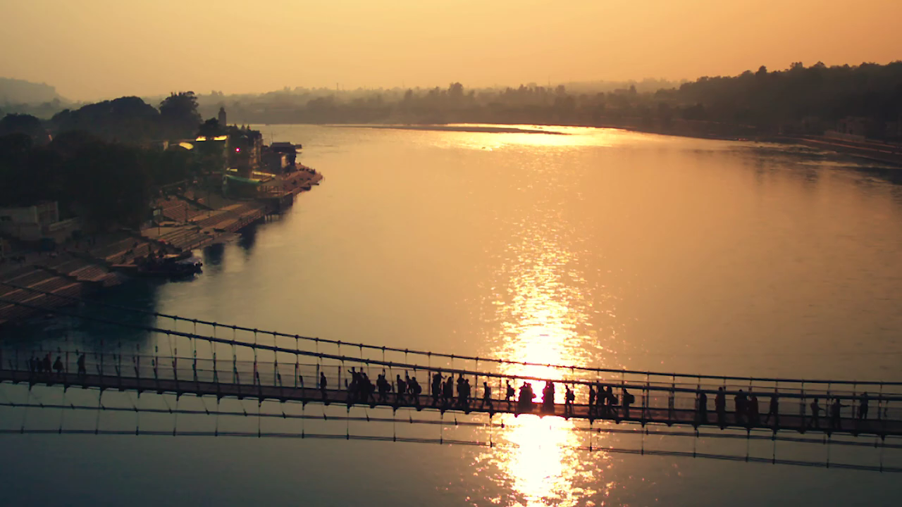
A Short Video on

Slide 6
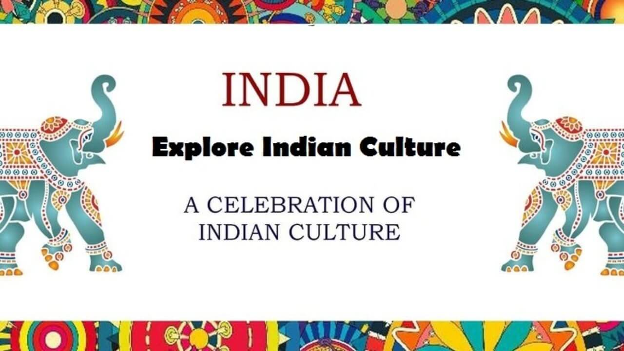
EXPLORE INDIAN CULTURE
AND
TRADITION
A CELEBRATION OF INDIAN CULTURE AND TRADITION

Slide 7
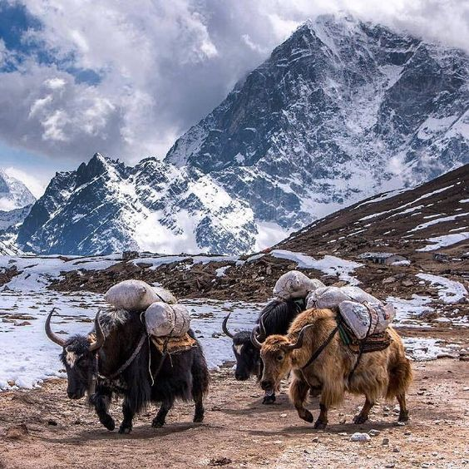
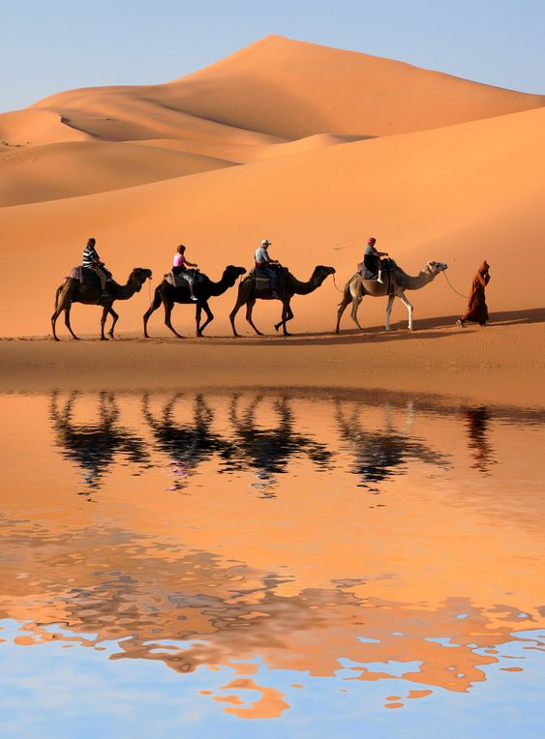
Topography
India is a country with various geographical terrains.
The Great Himalayan Range
The Never-Ending Deserts
The Lush Fertile Plains
Rich Plateaus

Slide 8
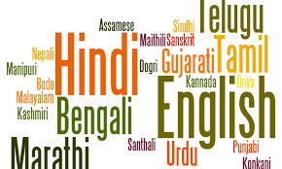
Languages
The language in India is extremely diverse. Changing cities leads to change in the local dialect. Hindi though spoken in most of the states also has a touch of the local region.
Maharashtrians speak Marathi, Punjabis speak Punjabi and likewise, all states have their own languages.

Slide 9
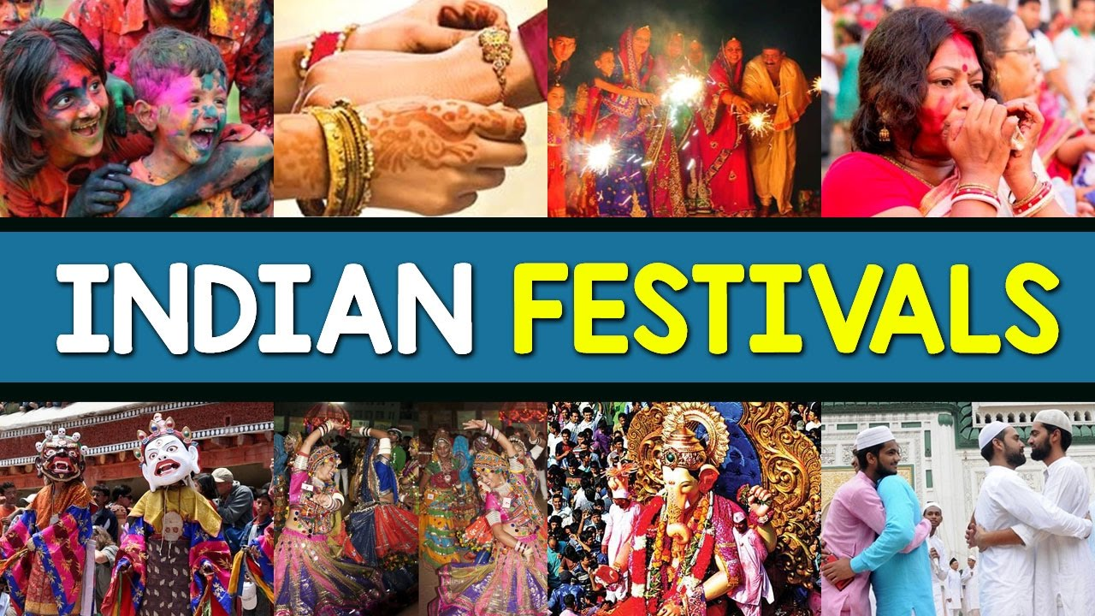
Festivals
Diwali and Holi are the two major Hindu festivals celebrated all over India. People of all religions celebrate festivals with equal fervor.
Eid is the major Muslim festival celebrated all over India. People hug each other on this occasion and promote peace and harmony.

Slide 10
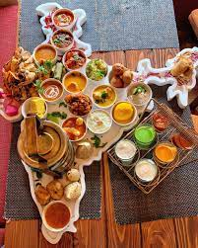
Food
For all the foodies out there, India is the country to visit for trying out a variety of different delicacies.
The Rajma chawal, Rogan Josh in Kashmir to the Chole Bhature in Punjab.
Fish curries in Bengal, idli dosa in South India, Butter chicken in Delhi, Punjab are few examples of famous delicacies.
Street food sold in the narrow lanes of India is mouthwatering and tasty.

Slide 11
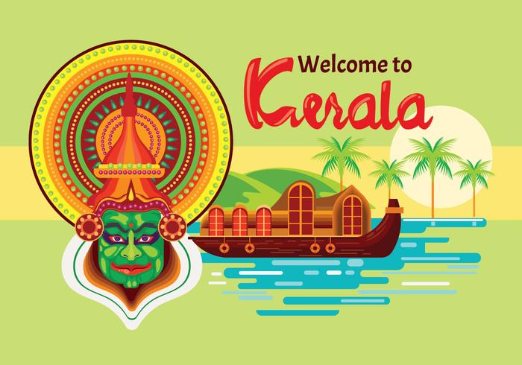
Festivals
Food
Kerala Tourism
Dance

Slide 12
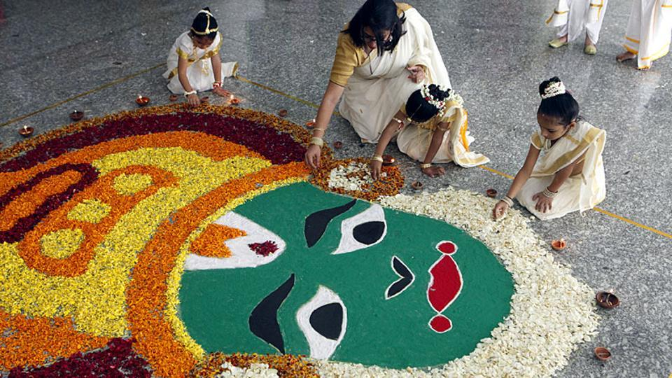
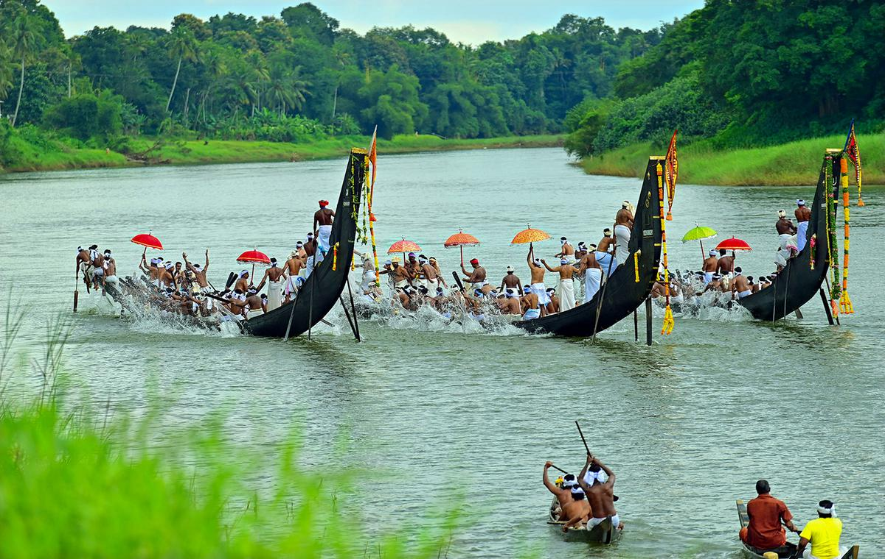
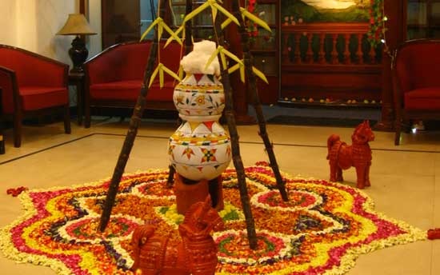
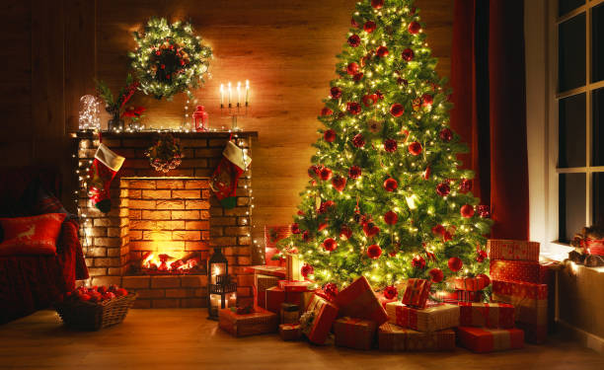
Onam
Boat Racing
Kerala Festivals
Pongal
Christmas

Slide 13
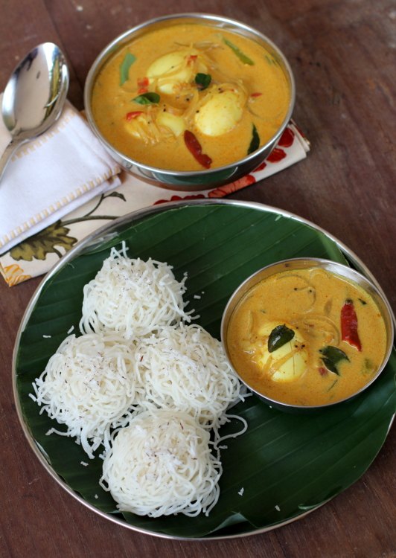
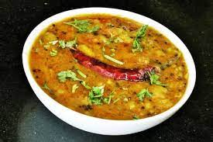
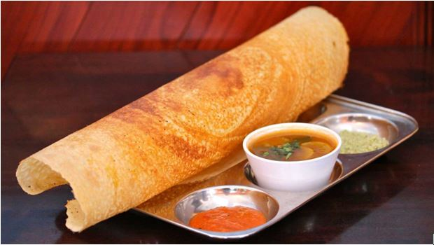
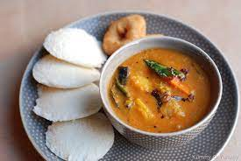
Idiyappam Curry
Dal Curry
Some famous food of Kerala
Dosa
Idli Sambar

Slide 14
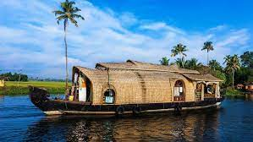
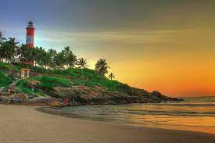
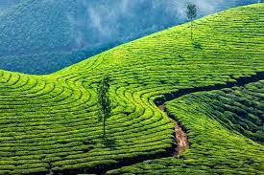
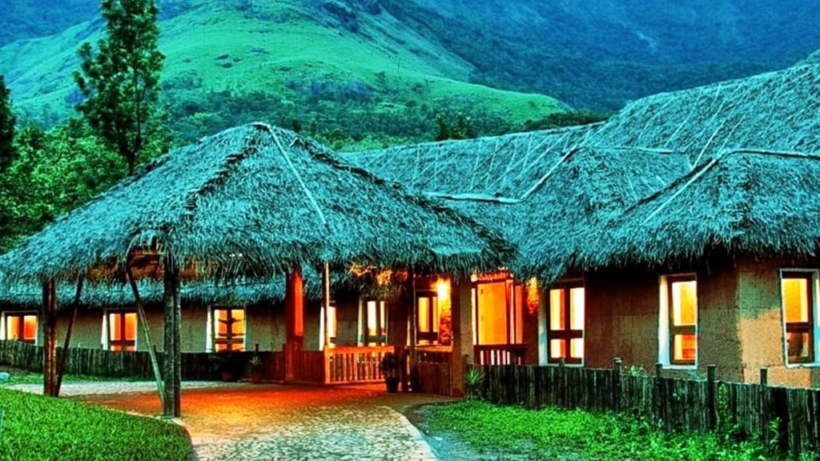
Alleppey
Kovalam
Kerala Tourism
Munnar
Wayanad

Slide 15
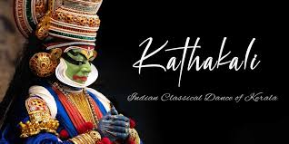
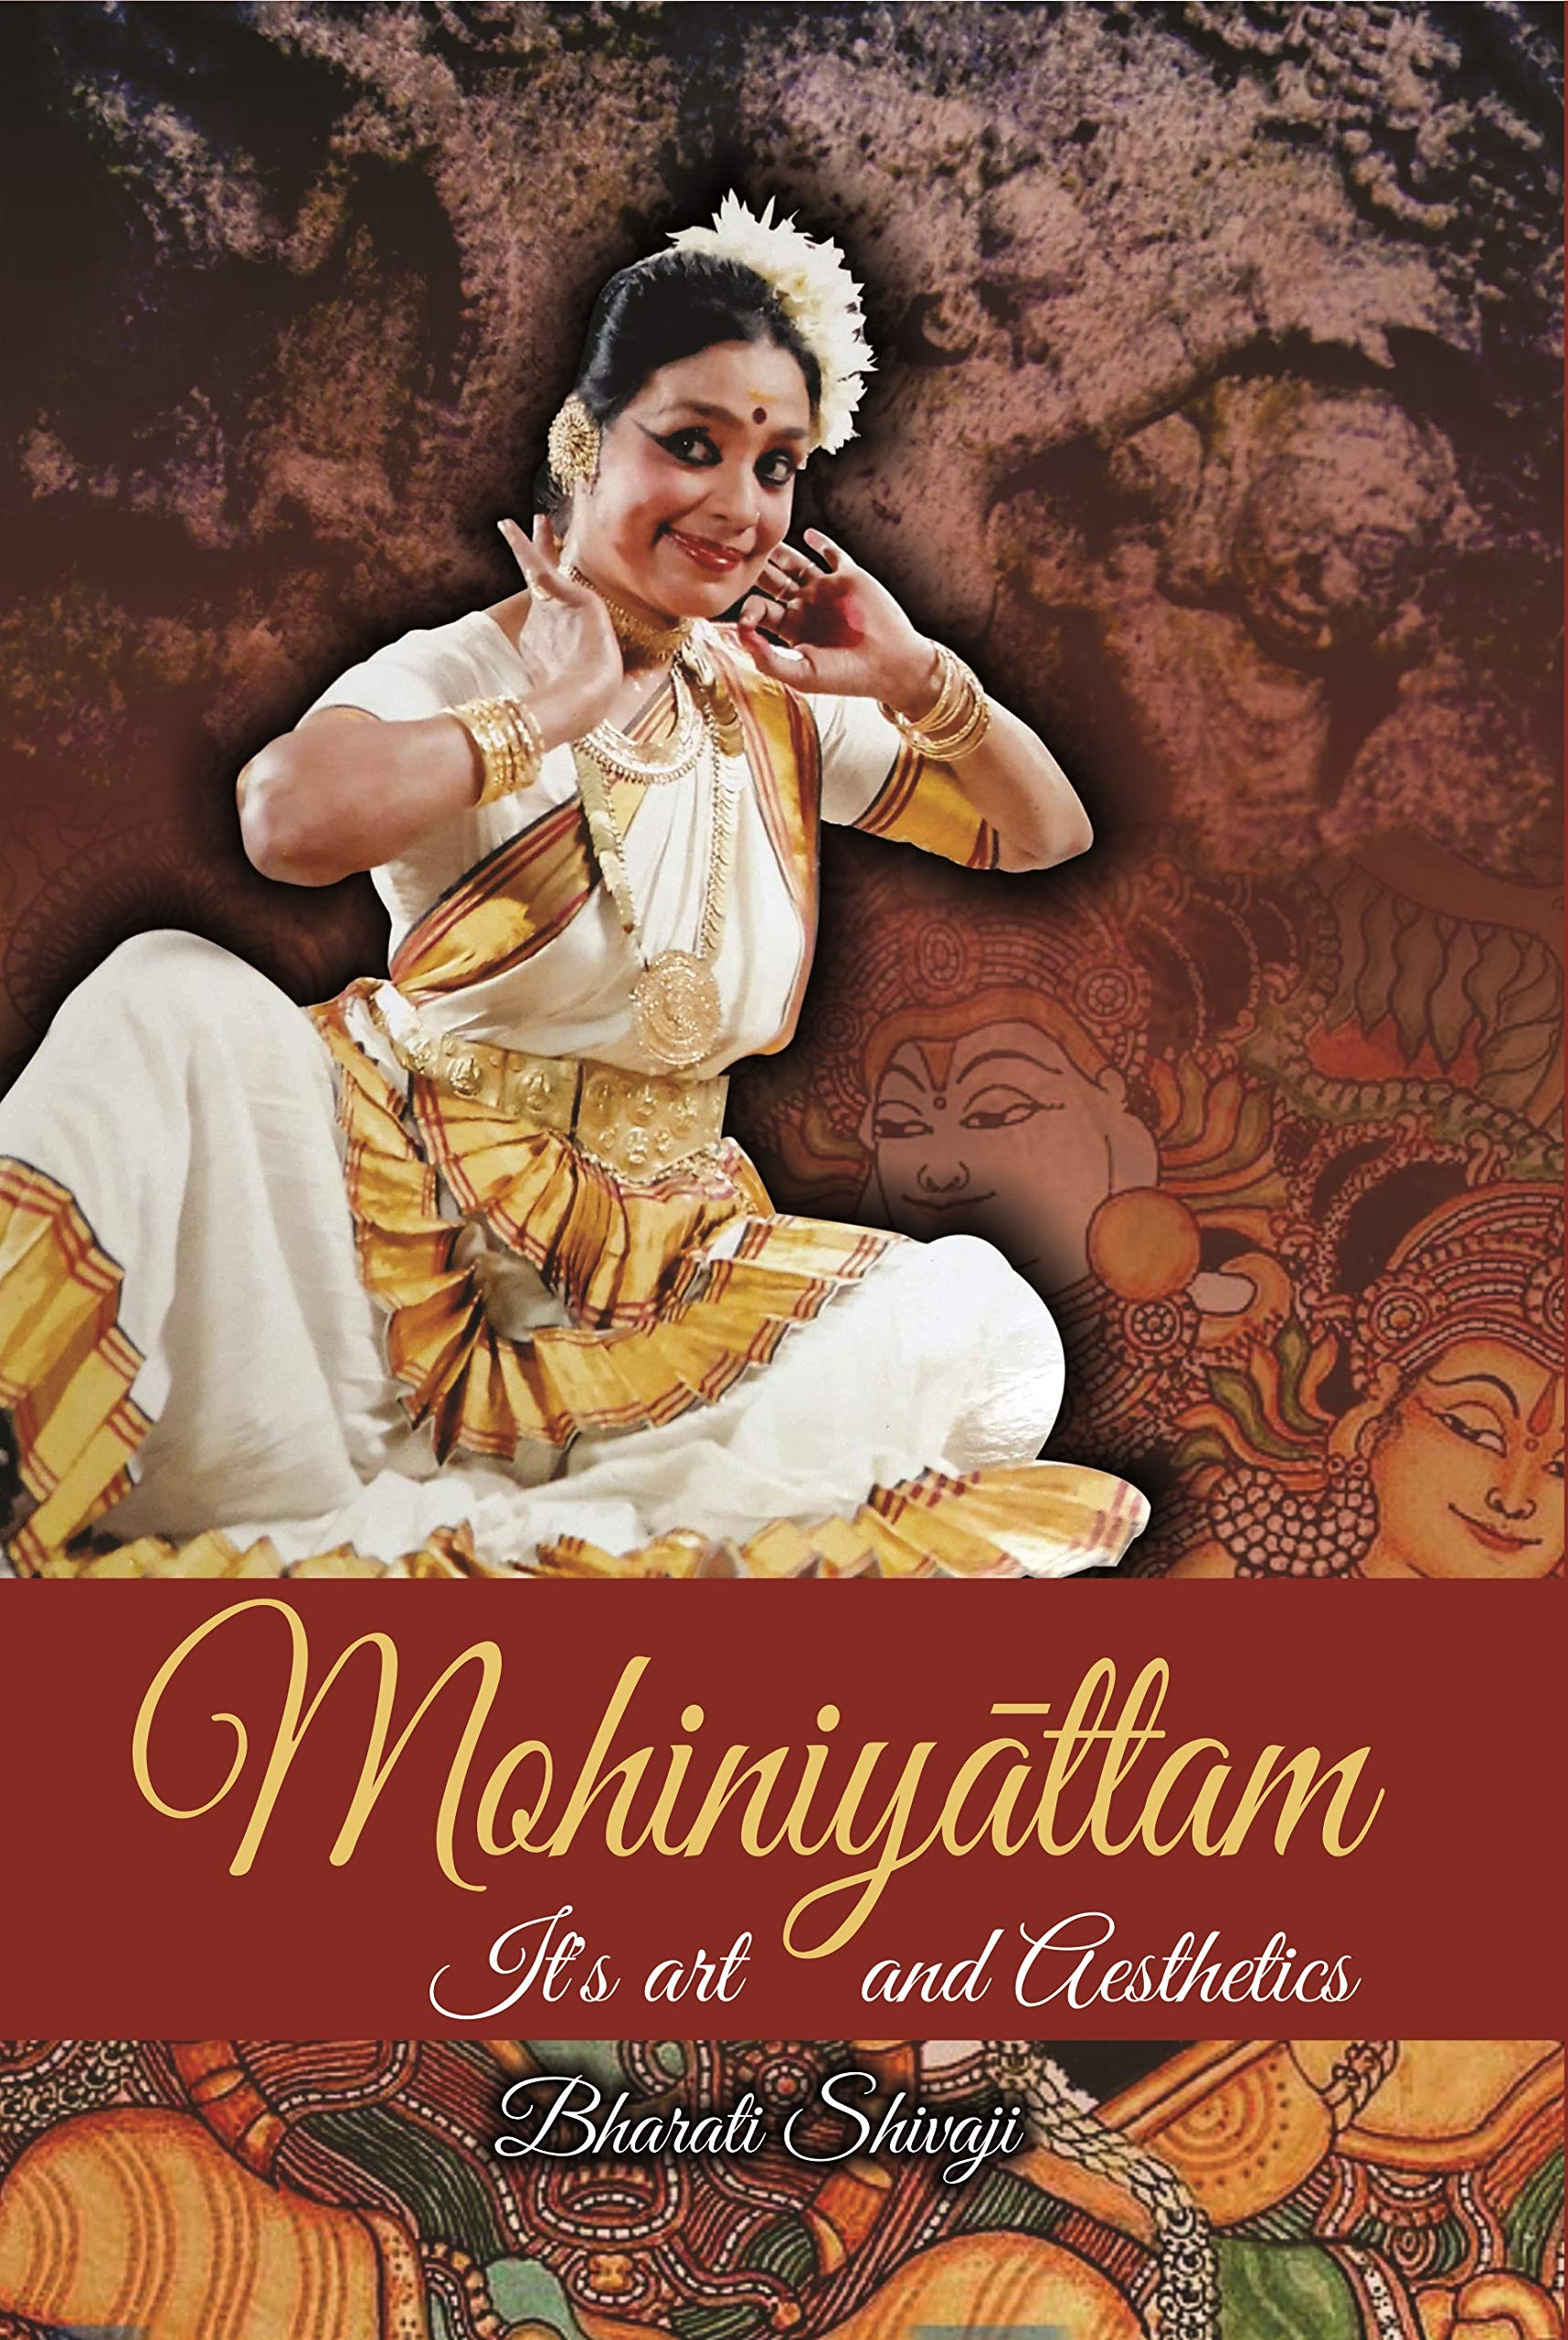
Famous classical dances of KERALA
Munnar
Wayanad

Slide 16
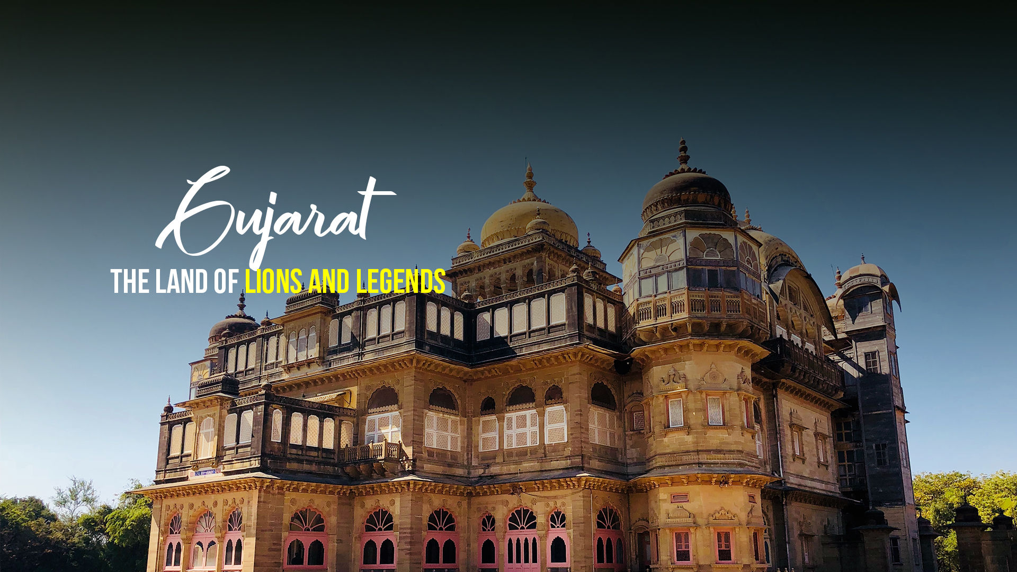
Festivals
Food
Gujarat Tourism
Dance

Slide 17
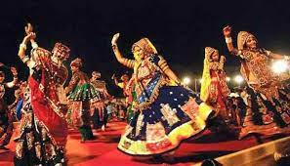
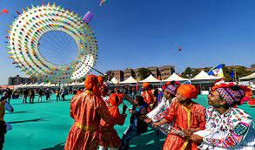
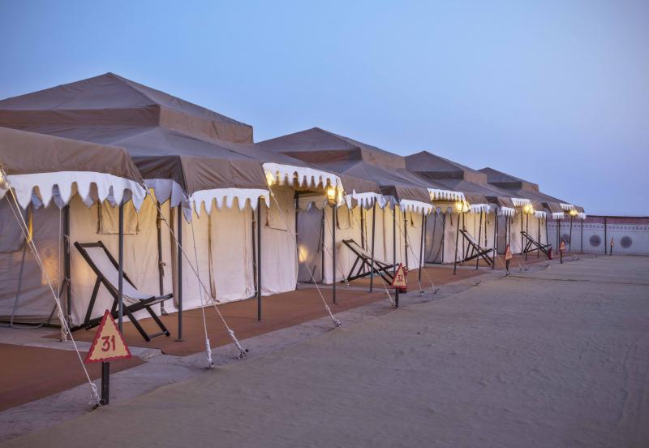
Famous Festivals of Gujarat
Navratri
Makar Sakranti
Rann Utsav

Slide 18
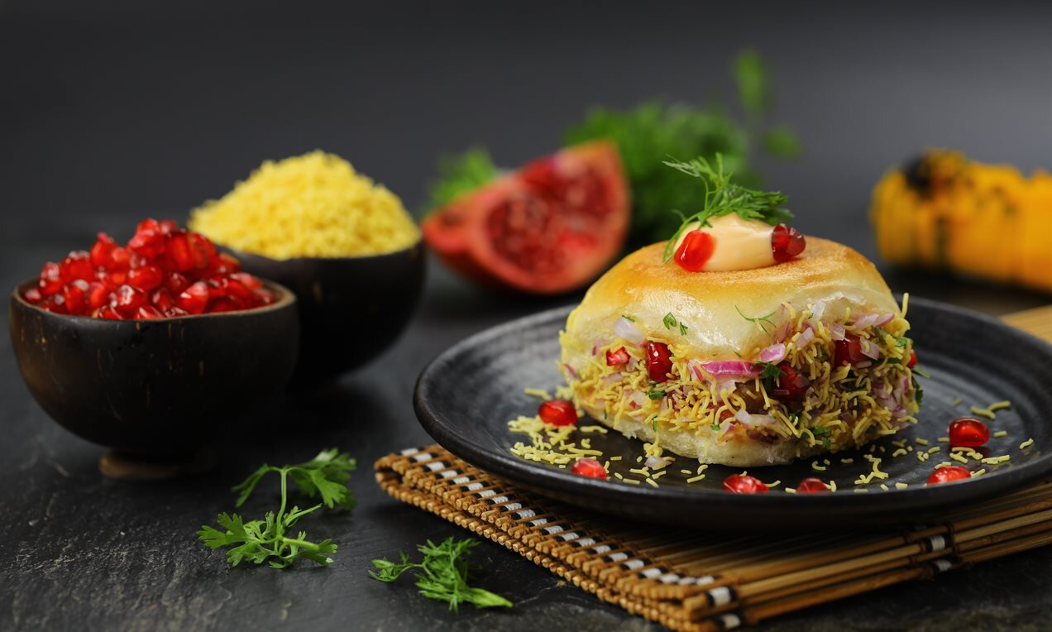
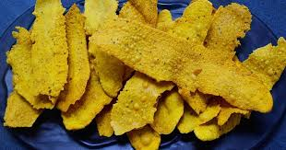
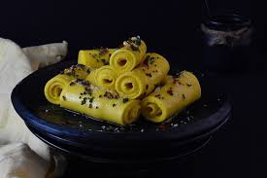
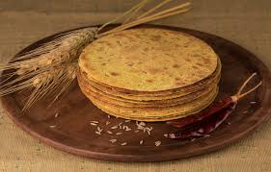
Dabeli
Fafda
Fafda
Some Famous Food of Gujarat
Khandvi
Khakhra

Slide 19
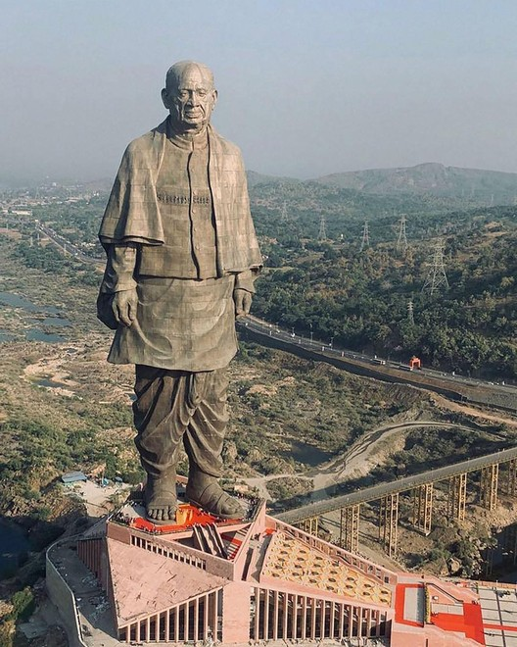
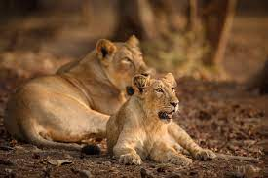
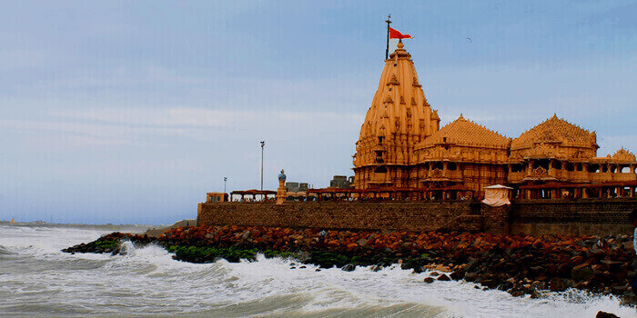
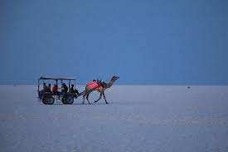
Statue of Unity
Gir National park
Gujarat Tourism
Somnath Temple
Rann of Kutch

Slide 20
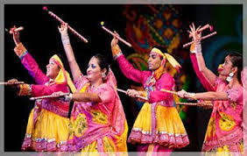
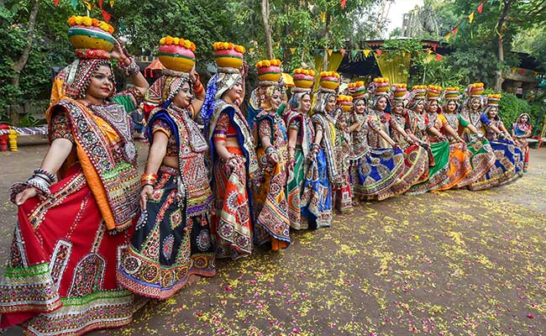
Gujarat Dance
The most famous folk dance of Gujarat is Garba and Dandiya.
Dandiya
Garba

Slide 21
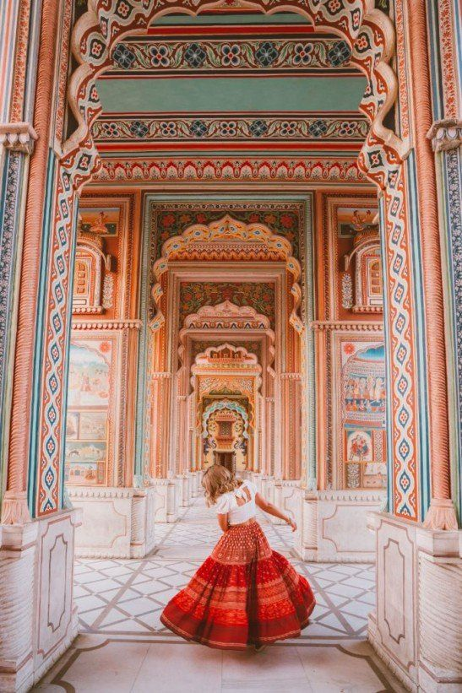
Rajasthan
Festivals
Food
Rajasthan Tourism
Dance

Slide 22
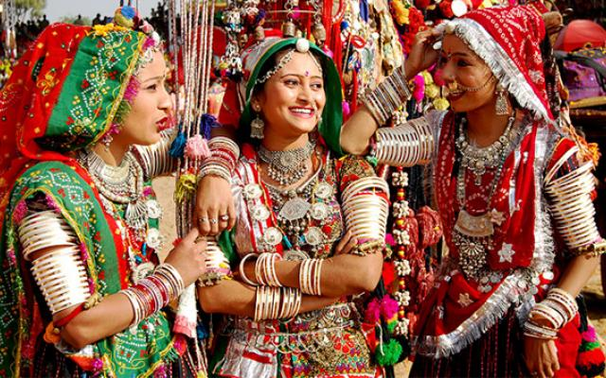
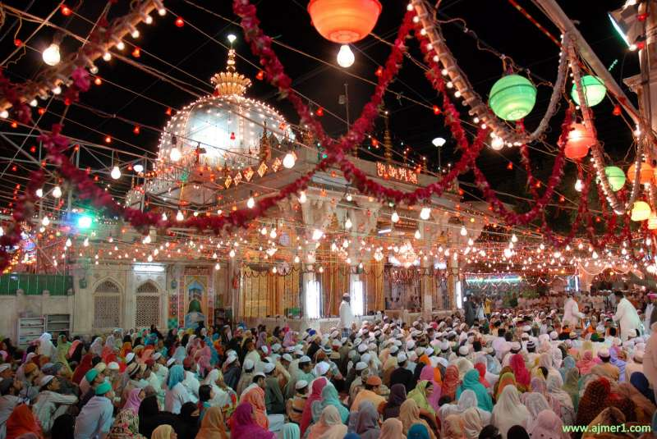
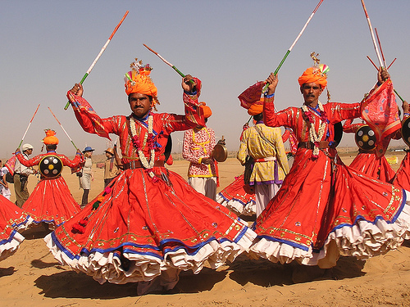
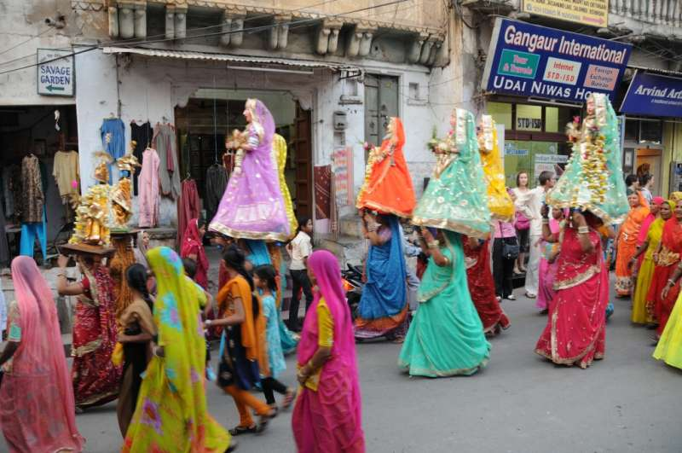
Teej Festival
Urs Festival
Rajasthan Festivals
Desert Festival
Mewar Festival

Slide 23
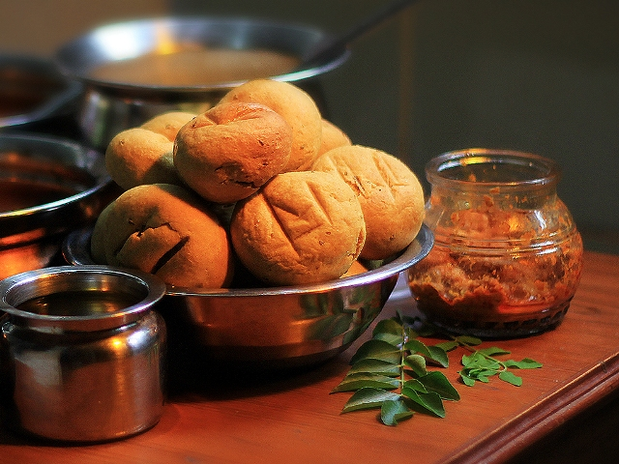
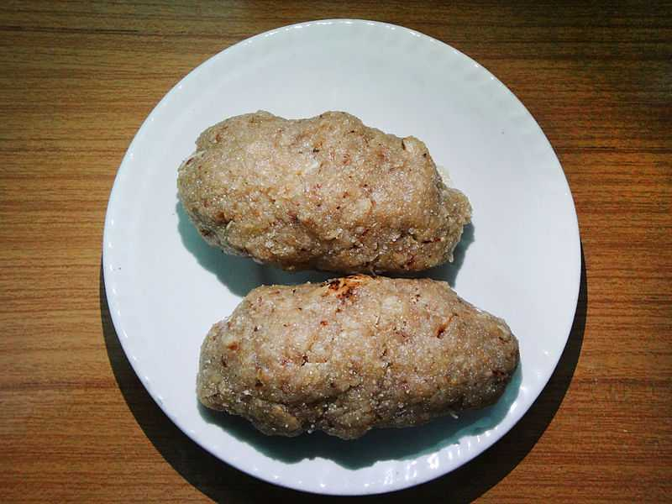
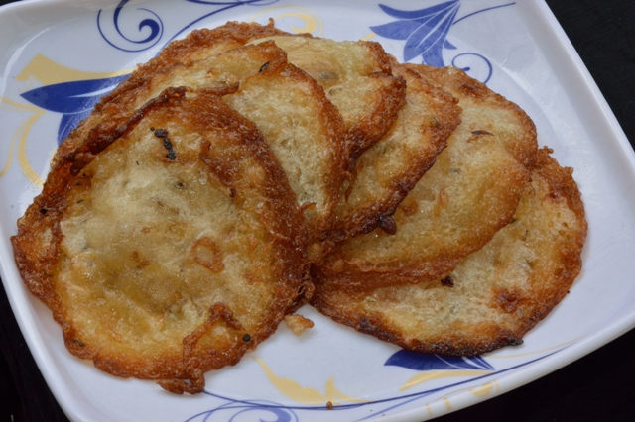
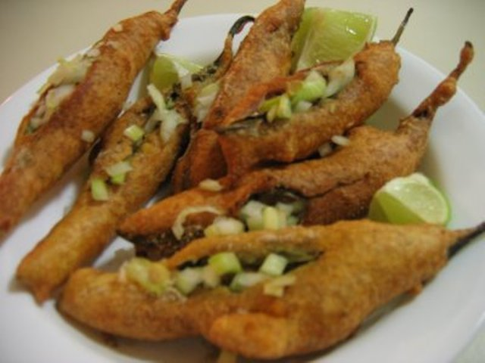
Dal Bati
Churma
Some Famous Food of Rajasthan
Malpua
Mirchi bada
Mal Pua
Mirchi Bada

Slide 24
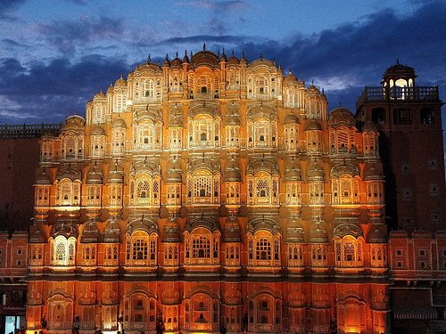
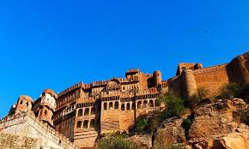
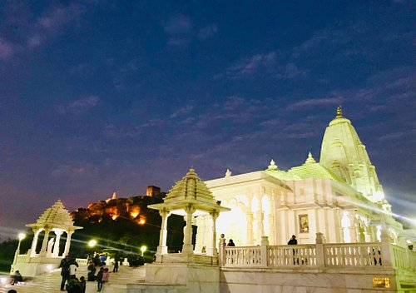

Hawa Mahal
Nahargarh Fort
Rajasthan Tourism
Birla Mandir
Udaipur

Slide 25




Bhavai
Kathputli
Famous Dances of Rajasthan
Ghoomar
Kalbelia

Slide 26
References
Images: https://in.pinterest.com/
Video: https://www.youtube.com/watch?v=yO7fQJKpqmI

Slide 27


